Slide 1
Crop classification using deep learning
Team Members Group:81 Panel Number:16
Project Advisor: Dr.S.Padmavathi Associate Professor(SG) , Department of CSE
SNo | Reg.No | Name of the Student | Section
1 | CB.EN.U4CSE18101 | AADHITH S. | CSE B
2 | CB.EN.U4CSE18118 | HAREESH V. | CSE B
3 | CB.EN.U4CSE18163 | VIGNESH H. | CSE B
4 | CB.EN.U4CSE18173 | THARUN KUMAR A. | CSE B

Slide 2
Problem definition
To develop a web application that would allow users to take images/upload images of different crops, crop fields, identifies the crop using Deep Learning and gives some insight on the crop.

Slide 3
Literature survey (Existing system)
S.NO | Authors Names | Title | Inference
1 | Shamsaldin, Ahmed & Fattah, Polla & Rashid, Tarik & Al-Salihi, Nawzad | The Study of The Convolutional Neural Networks Applications,2019 | CNN architecture consists of multiple trainable multilayer levels, used for segmentation, classification and image processing.
2 | Arnold, Taylor B. | kerasR: R Interface to the Keras Deep Learning Library, 2017 | Highly approachable, extensive, user-friendly interface to design machine learning and deep learning models.
3 | A.Shrestha and A.Mahmood | Review of deep learning algorithms and architectures,2019 | AI function that mimics human brain in processing data for object detection.
4 | Rohith Sri Sai, Mukkamala & Rella, Sindhusha & Veeravalli, Sainagesh | OBJECT DETECTION AND IDENTIFICATION A Project Report,2019 | Using dependencies such as TensorFlow, OpenCV, imageai, etc, we can detect each and every object in image by the area object in an highlighted rectangular boxes and identify each and every object and assign its tag to the object.
5 | Swu, Vikaho & Kharir, Ibaphyrnaishisha & Bora, Dibya. | Identification of Different Plants through Image Processing Using Different Machine Learning Algorithms,2020 | Image processing technique is considered as the main method for classifying different characteristics or specific portions or regions of the plant leaves

Slide 4
Justification for the proposed problem
Motivation and Need
The modern lifestyle has made people less aware of where we get our food from. From a commoner's perspective, it may seem irrelevant but it is our responsibility and a necessary knowledge to know where, how and when our food is being produced. So we are designing a web-based application where a user can upload an image/images to gain insight into the crop.

Slide 5
Software/Tools Requirements
HTML, CSS, Js, BootStrap – Front-end
NodeJS, Express – Back-end
MongoDB – Database
Python – Programming language for Deep Learning
Keras – Python library to design Deep Learning models.
OpenCV – Open source computer vision and ML library
TensorFlow – a open source library used for machine learning applications

Slide 6
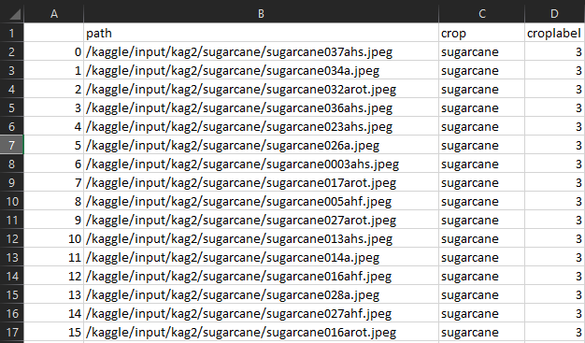
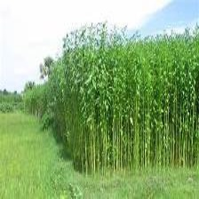
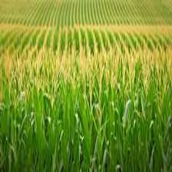
Data Sets
Link to dataset 1: https://www.kaggle.com/aman2000jaiswal/agriculture-crop-images
Link to dataset 2: https://edenlibrary.ai/
Jute
Maize
Since our project is based on a Deep Learning application of identifying crops
using field images of crops, we require images of crops to train and test our
Deep Learning model. So we have decided to use these 2 datasets that consists of
images of various varieties of crops and plants.

Slide 7
Work Plan
Collect dataset containing images of various crops to train and test the DL model
To create an efficient Deep Learning Model
to identify the crops
To create User-interface for the web-app
To deploy the application online
Integrate DL Model with the interface

Slide 8
Conclusion
We have gone through various resources to get an idea on how to proceed with our project. We will apply what we have learnt and will also learn in the course of our project execution period. At the time of completion we would have developed a working web application that identifies crop based on its image. We expect this project to give the users more affinity towards farming and pave a path to bring awareness on agriculture as a profession.

Slide 9
References
Shamsaldin, Ahmed & Fattah, Polla & Rashid, Tarik & Al-Salihi, Nawzad. (2019). The Study of The Convolutional Neural Networks Applications. UKH Journal of Science and Engineering.3.10.25079/ukhjse.v3n2y2019.pp31-40
Arnold, Taylor B.. “kerasR: R Interface to the Keras Deep Learning Library.” J. Open Source Softw. 2 (2017): 296
A. Shrestha and A. Mahmood, “Review of deep learning algorithms and architectures,” IEEE Access, vol. 7, pp. 53040–53065, 2019.
Rohith Sri Sai, Mukkamala & Rella, Sindhusha & Veeravalli, Sainagesh. (2019). OBJECT DETECTION AND IDENTIFICATION A Project Report
Swu, Vikaho & Kharir, Ibaphyrnaishisha & Bora, Dibya. (2020). Identification of Different Plants through Image Processing Using Different Machine Learning Algorithms. 43. 172-179.

Slide 10
THANK YOU

